Slide 1

Professional Identity- Creating your Professional Brand Design for Life PF2: The Scientist: Professional Formation 2 Assoc Prof. Caoimhe Clerkin
17.3.25

Slide 2
Recap on Professional Branding 1
In our last session together, we worked on
Body language and how we can use this to make use feel more confident
Thought about the ‘why’
Considered our personal values
Thought about emotional intelligence using Johari’s Window

Slide 3
Today
We will build on these skills and consider how professional identity can shape
Job applications
Career success
Building relationships and hence leadership

Slide 4
ASSESSMENT
You will be assessed in this module by continuous assessment (100%) and is comprised of three assessment tasks
Assessment Task 1: Abstract Development (40%)- Due date 7th April and relates to workshop delivered on 24th March
Assessment Task 2: Mock interview(30%)- Will be scheduled for the week commencing 7th April and relates to workshop delivered on 17th and 31st March
Assessment Task 3: Reflective Writing (30%)- Due date 21st April and feedback you have received from assessment task 1 and 2 and learnings from PF1 and PF2.

Slide 5
By participating in this workshop you will be preparing for Assessment 2 and Assessment 3 ‘Failing to prepare, is preparing to fail’.
17.3.25

Slide 6
Part 1: Introduction to Professional Identity
17.3.25

Slide 7
What is Professional Identity?
Professional identity can be described as the unique combination of personal and professional attributes that shape how others perceive you in the workplace
Its significance is to :
- Enhance visibility and recognition in the scientific community.
- Open up opportunities for collaboration and funding.
- Build credibility and trust with peers and stakeholders.

Slide 8

Values: Commitment to education and student development.
Skills: Effective communication, lesson planning, classroom management.
Behaviours: Encouraging student participation, adapting teaching methods to diverse learning needs.
Impact: A teacher who students want to learn and develop from

Slide 9

Values: Compassion, patient care, ethical responsibility.
Skills: Clinical knowledge, patient assessment, teamwork.
Behaviors: Providing empathetic care, following medical protocols, collaborating with healthcare teams.
Impact: A trusting nurse who can help patients to recover

Slide 10

Why does Professional Identity matter?
Values: Lacks compassion and dedication to patient care.
Skills: Limited clinical knowledge and teamwork skills.
Behaviours: Provides minimal care, often overlooks protocols, and struggles to work with healthcare teams.
Impact: Incompetent nurse who has little trust from her patients

Slide 11
Why does Professional Identity matter?
Having good values, skills and behaviours allows you to succeed in your career, establish trusting relationships with colleagues, lead your team to success and provide you with job satisfaction….and more

Slide 12

Your turn
As a Level 1 Bsc ATT student,
What are your
Values
Skills
Behaviours
What impact will this have on your studies?

Slide 13
Introduction to Mindmapping
Mindmaps allow us the space and time and time to consider all options of a question
Where do you want to go?
Who do you want to become?

Slide 14
Warm-up exercise
Use mindmapping to plan a teacher-student activity event.
You have 20 minutes

Slide 15
De-brief
What did that feel like?
Did anyone get stuck?
Were you ever frustrated?

Slide 16
Part 2: Elements of Building Your Professional Brand
17.3.25

Slide 17
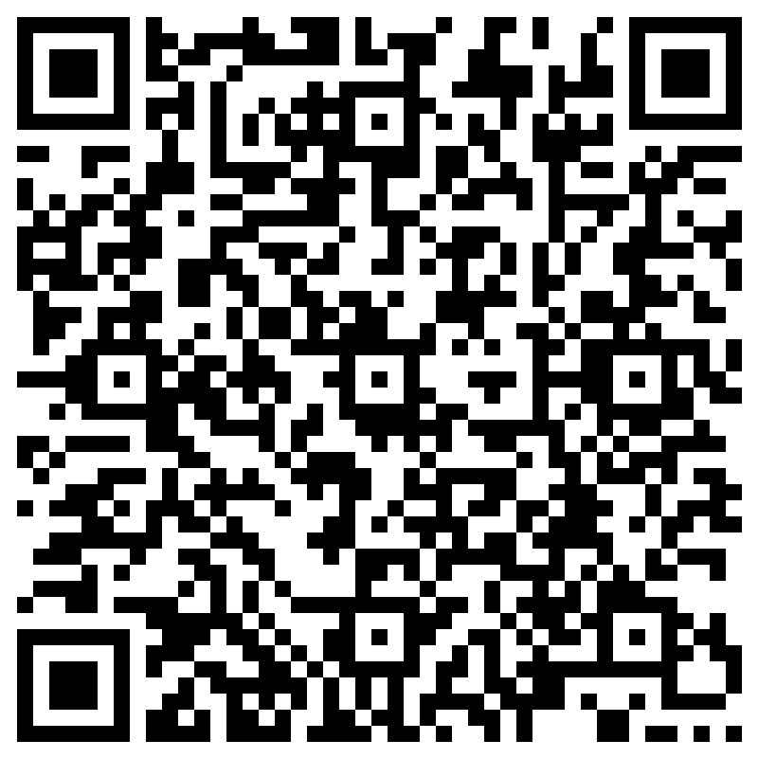
Why did you choose to study ATT at the ICPI?
Be as honest as you dare- this is anonymous!

Slide 18
What skills and expertise will a graduate of ATT have?
https://www.rcsi.com/dublin/undergraduate/advanced-therapeutic-technologies/course-details

Slide 19
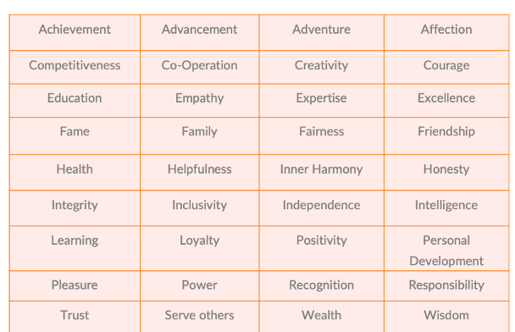
How do your values align with becoming a ATT scientist?
Remember you chose only 5 values

Slide 20
What behaviours should you demonstrate to become an excellent ATT scientist?

Slide 21
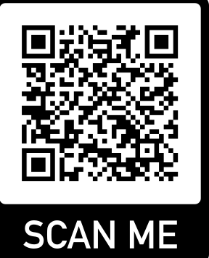
Your turn
Assessment Task 2: Mock interview(30%)- Will be scheduled for the week commencing 7th April and relates to workshop delivered on 17th and 31st March
The TASK (25 minutes):
Read the following job opportunity and consider how your skills, values, align with this role.

Slide 22
Part 3: Preparation for interview
17.3.25

Slide 23
CV and Cover Letter
For many job applications you will be required to write a C.V. and cover letter
We will consider this on the 31st March during our lecture on Build your CV and Professional Profile
Today’s focus is the interview and we can spend this time presenting our professional brand

Slide 24
How this session will work
Brainstorm potential interview questions
Answer the key interview questions
I will then select a student to answer a question in the class

Slide 25
Let’s brainstorm some questions we could be asked during the interview (15 minutes)

Slide 26
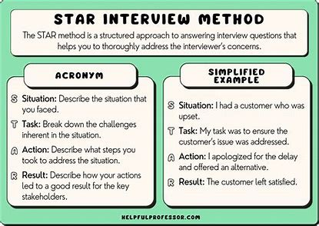

Slide 27
Example
Q. Team-work is a key skill we require all employees of Pfizer to have. Can you give an example of how you demonstrate team work?
Situation | Task | Action | Result
I was working with four members on a group presentation as part of my The Scientist: Professional Formation Module | The presentation was demonstrating the importance of critical thinking as an ATT student | I split out tasks for our group to cover the main objectives of the presentation for example Presentation design Research on the importance of critical thinking Communicating these ideas | The team and I received a first class honours classification for our presentation

Slide 28
Using the STAR technique
Answer the selected key interview questions

Slide 29

De-brief
What did that feel like?
Did anyone get stuck?
Were you ever frustrated?

Slide 30
Part 4: Professional branding online
17.3.25

Slide 31


How can you brand yourself online?

Slide 32
The importance of Email
Email is the primary form of communication between colleagues and future employees.
To write an email correctly you should include the following
Subject – this is a title to your email
Address- this will greet the intended receiver
Body of the email- this will include why you are writing the email and what question you would like answered. It will also contain detail of why this question needs to be answered
Conclusion- close off the email by thanking the reader for their attention.

Slide 33
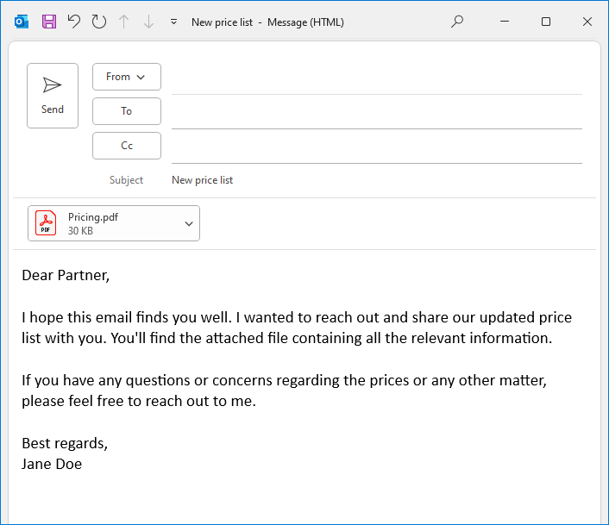
Example
To write an email correctly you should include the following
Subject – this is a title to your email
Address- this will greet the intended receiver
Body of the email- this will include why you are writing the email and what question you would like answered. It will also contain detail of why this question needs to be answered
Conclusion- close off the email by thanking the reader for their attention.

Slide 34
Your turn
Assessment Task 2: Mock interview(30%)- Will be scheduled for the week commencing 7th April and relates to workshop delivered on 17th and 31st March
Write a mock email to Pfizer telling them that you are interested in the student placement role. You can send this to me and I will provide feedback caoimheclerkin@rcsi.ie

Slide 35
What is Linkedin?
LinkedIn is a professional networking platform.
It allows users to connect with colleagues, search for jobs, and share professional content.
LinkedIn features include:
- Profile creation
- Networking
- Job searching
- Content sharing

Slide 36
What is Linkedin?
A strong online persona helps in:
- Establishing credibility
- Networking with professionals
- Enhancing career opportunities
Showcasing skills and achievements
Tips for building a strong online persona:
- Keep your profile updated
- Share relevant content
- Engage with your network

Slide 37
What is Linkedin?
Privacy and professionalism are crucial in the digital age.
Key points to consider:
- Protect your personal information
- Be mindful of what you share online
- Maintain a professional tone in communications
- Understand privacy settings on platforms like LinkedIn

Slide 38
Part 5: Cultural Nuances and Global Perspectives
17.3.25

Slide 39
Chinese Professional Identities
There are many traditional Chinese values that impact professional interactions
Can you think of any?

Slide 40

Quick, immediate responses
Less emphasis placed on checking emails
Less formal
Slow responses
More detailed responses
More formal

Slide 41

A simple example of how Chinese professionals have successfully integrated their identity in global environments is Eric Yuan, the founder of Zoom
He brought his background and experiences from China to the U.S., where he created a globally successful video conferencing platform.
Understanding Chinese Work Culture: 2025 Guide for Leaders

Slide 42
What can we ALL do to adapt to cultural expectations when working internationally?
Cultural competency
Clear communication
What can you think of?

Slide 43
Any other items

